Slide 1

Can our eyes
deceive us?

Slide 2
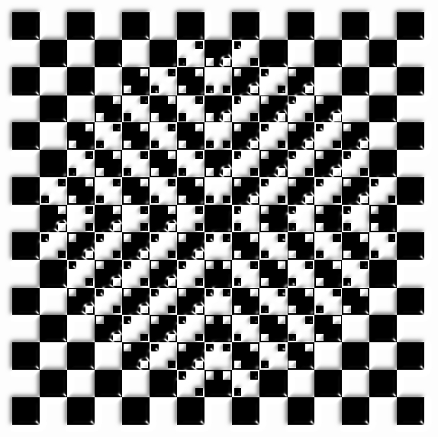
Does the middle of this square seem to bulge out?
Actually, all the lines are straight!
Optical illusions fool our brains into seeing things that are not really there!

Slide 3
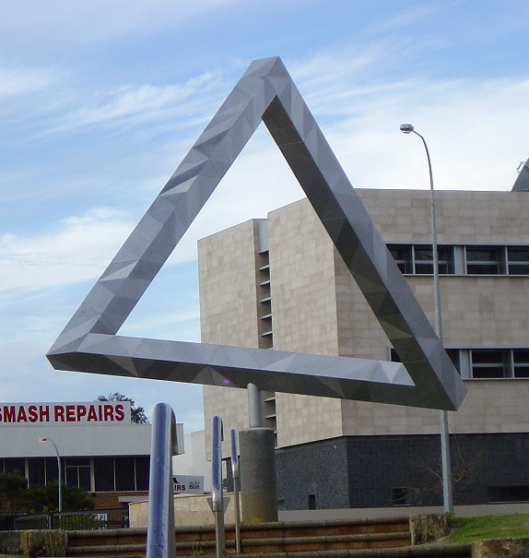
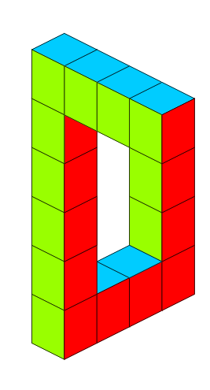
This illusion is called the Penrose Triangle.
They liked the idea so much in Australia, they built one!
The Penrose Triangle in Perth

Slide 4
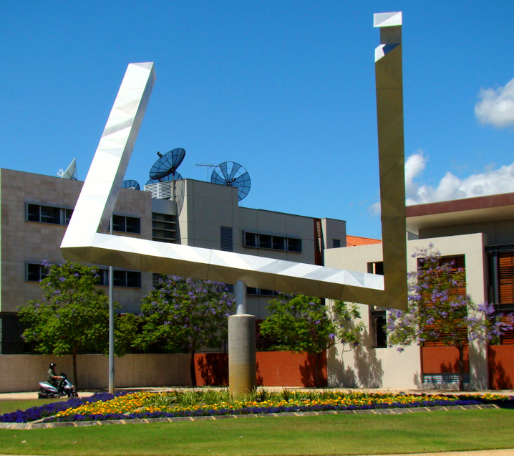

Here’s what it looks like from a different angle!!

Slide 5
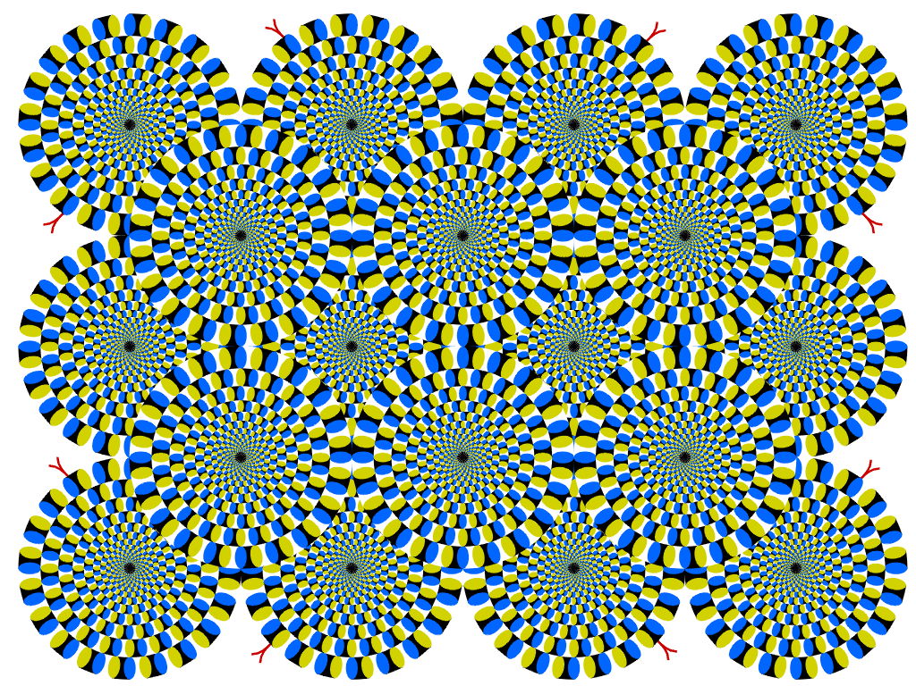

This illusion fools us into thinking that something is moving!
It was created by Professor Akiyoshi Kitaoka
There are more of the Professor’s illusions on the FaradaySchools website

Slide 6

The apparent rise and setting of the Sun each day fooled people for thousands of years into thinking that the Sun moves around us

Slide 7
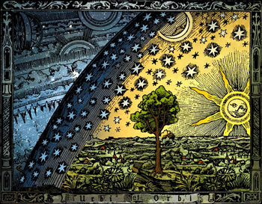
In the days of the ancient Hebrews, when the Creation story of Christianity, Judaism and Islam was written, most people's idea of the universe was something like this

Slide 8
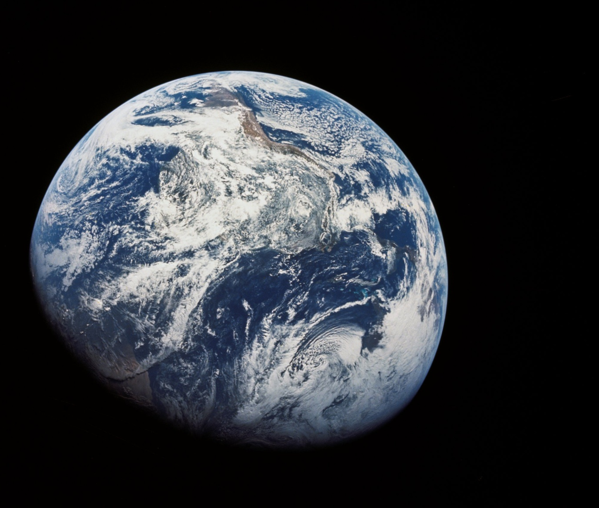

Our understanding today is supported by convincing evidence including photos of the Earth from space.

Slide 9
And now you’ve finished this section!
Close the window and see what’s next.

